Slide 1

Defining Your Sales Process

Slide 2
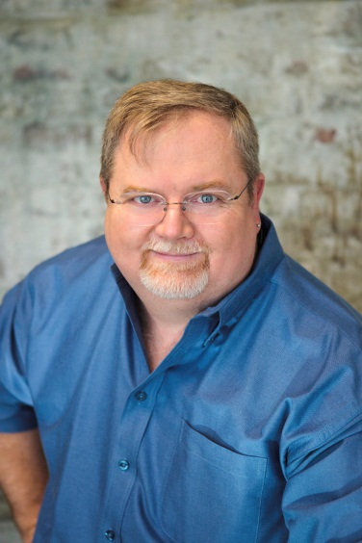
Mitch Milam
Dynamics CRM Architect
Independent consultant
Ten–Time Dynamics CRM MVP
Contact me:
mitch@xrmcoaches.com
Infinite–x.net
@mitchmilam

Slide 3
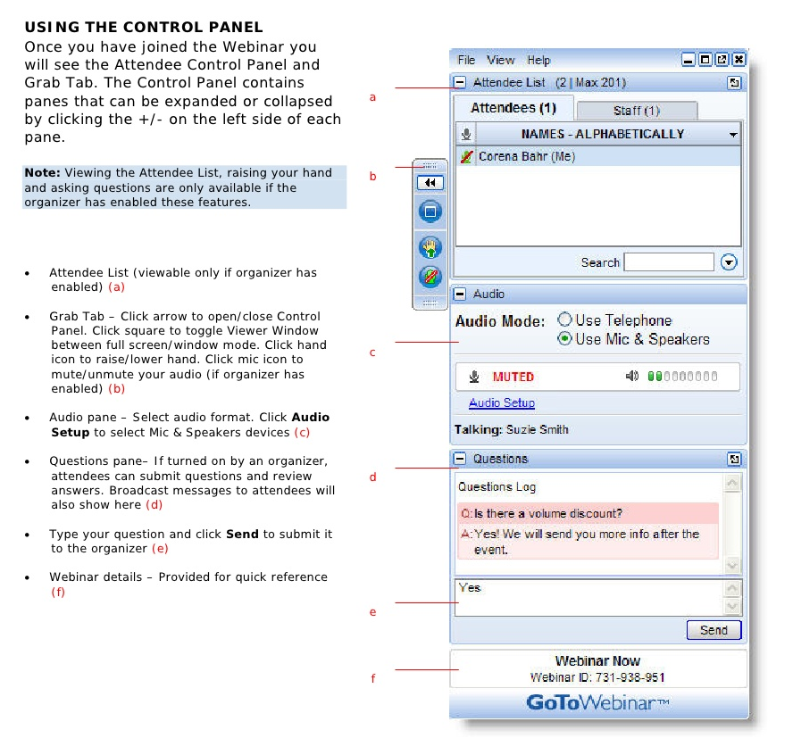
Webinar Housekeeping

Slide 4


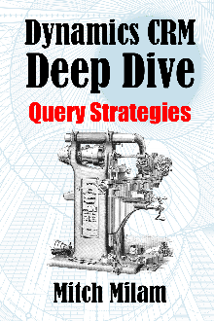
2016 Training Roadmap
Webinars
http://www.xrmcoaches.com/webinars
KnowledgeBits
http://www.xrmcoaches.com/knowledgebits
Learning Plans
http://www.xrmcoaches.com/freestuff
More Goodies
Practice tests
On–Demand video training
Instructor–led training
Books

Slide 5
Agenda
Sales process basics
Creating a great sales process
Working with the sales process within Dynamics CRM
Tips and Tricks

Slide 6


Slide 7
Rule #1
Technology does not fix process issues

Slide 8


Slide 9
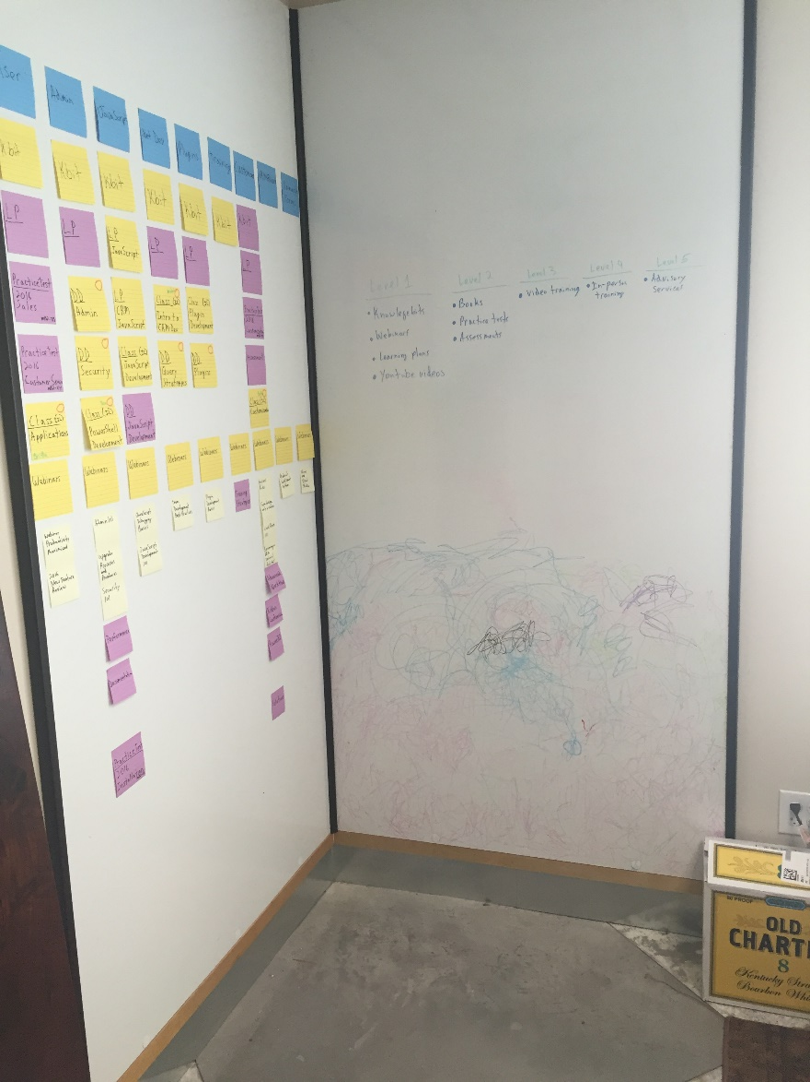

Slide 10
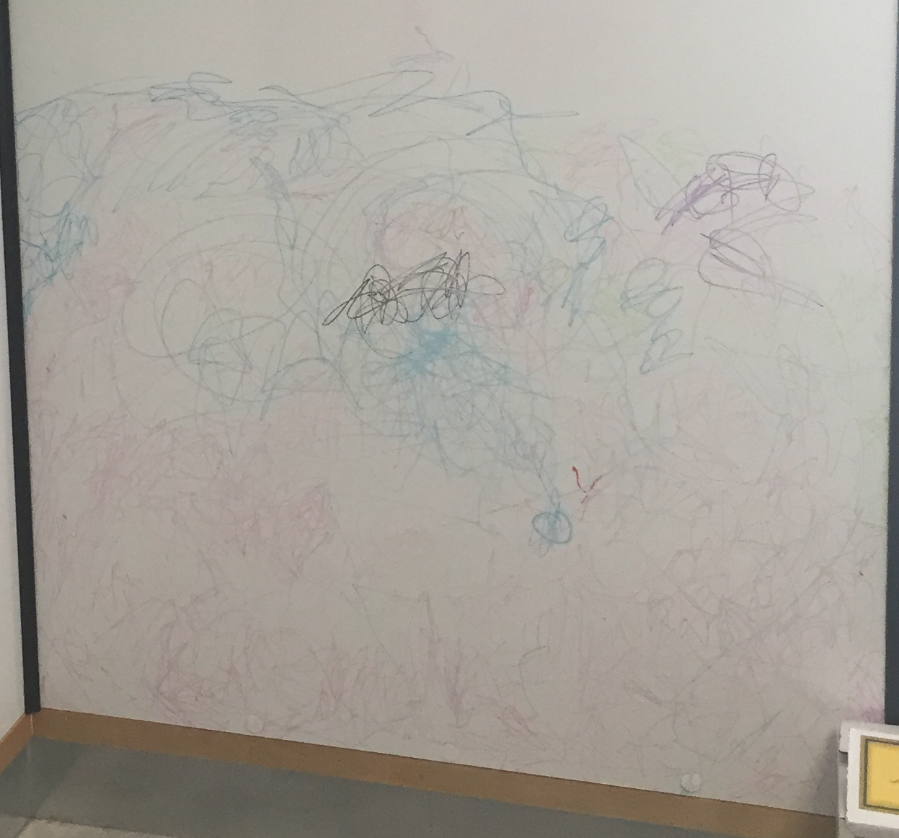

Slide 11
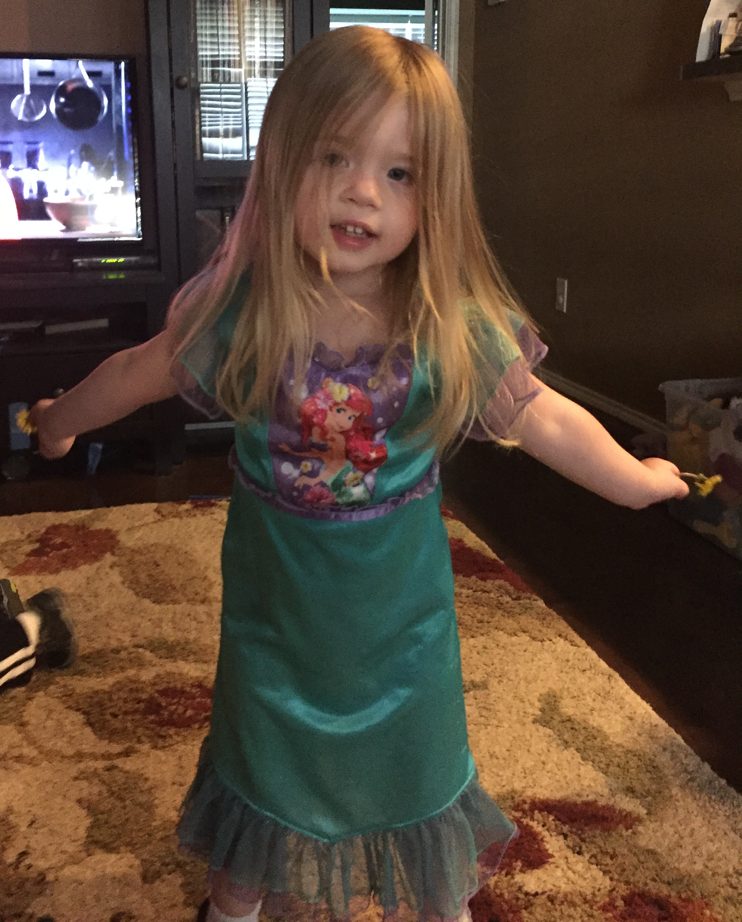

Slide 12
Propose
Close
Qualify
Develop

Slide 13
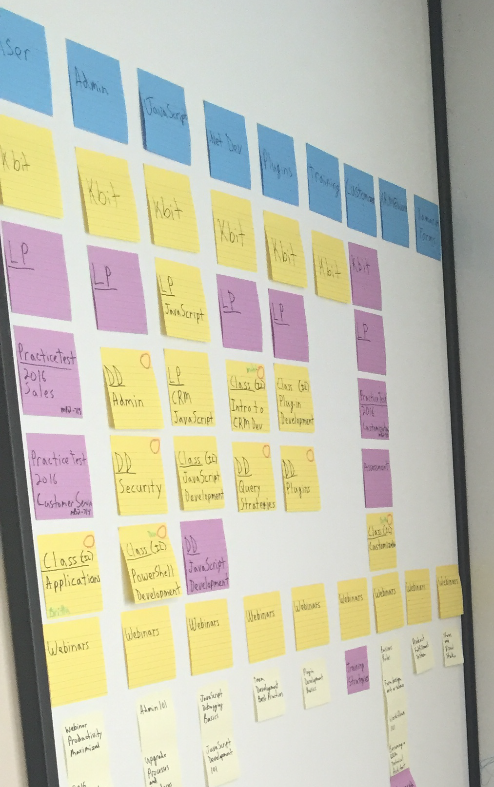

Slide 14
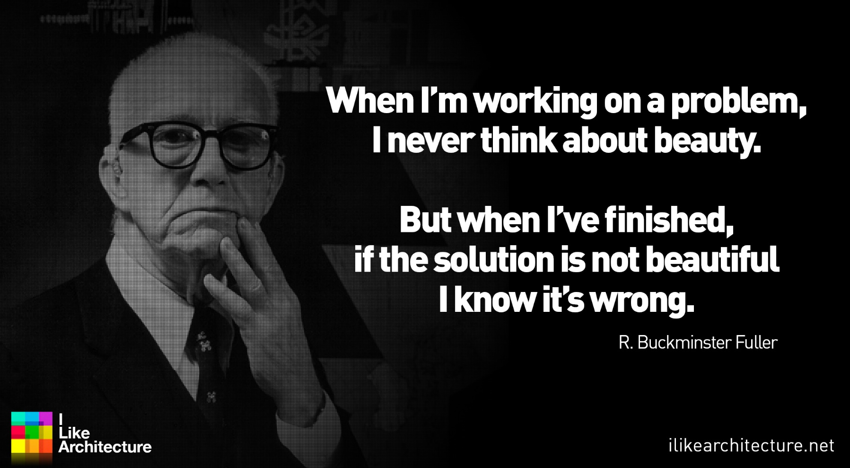

Slide 15
Creating a great sales process

Slide 16
Agreement

Slide 17
Sponsorship

Slide 18
Execution

Slide 19
Follow-Through

Slide 20
Sales Process Review
Agreement
Sponsorship
Execution
Follow-through

Slide 21
Sales Process Entities
Lead
Account
Contact
Opportunity

Slide 22
What is a Lead?

Slide 23
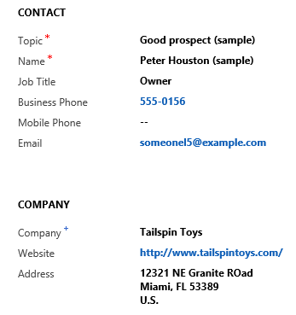
Lead Detail

Slide 24
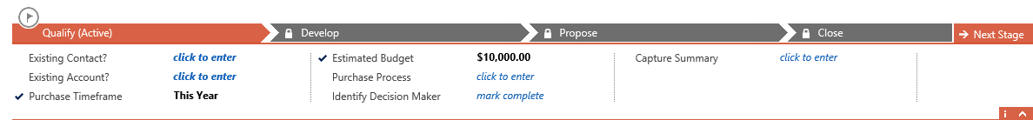
Lead Business Process Flow

Slide 25
Lead Conversion Process
Lead
Account
Contact
Opportunity

Slide 26
What is an Opportunity?

Slide 27
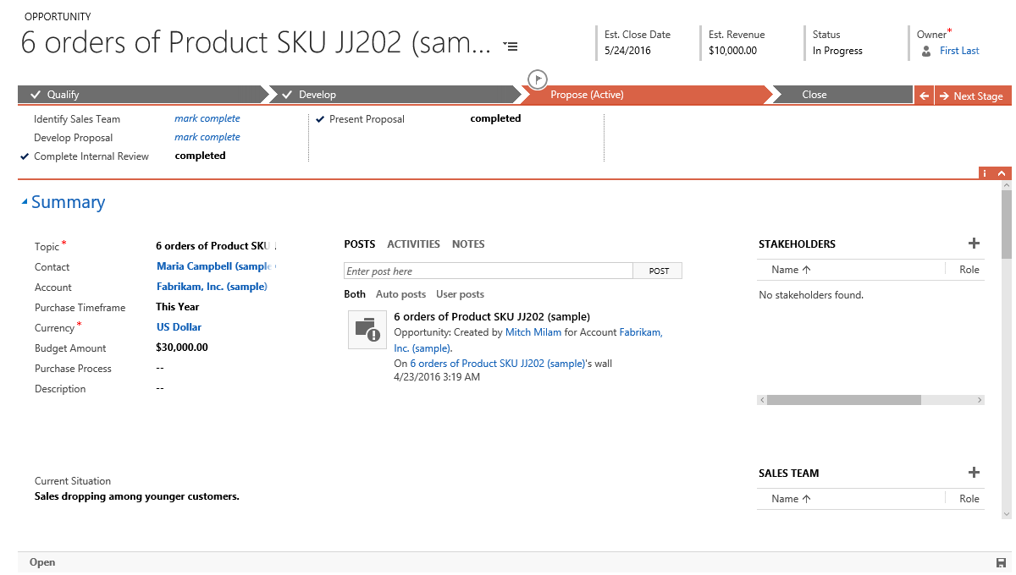
Opportunity Detail

Slide 28
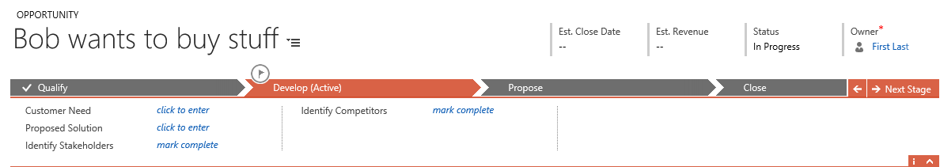
Opportunity Business Process Flow

Slide 29
Sales Pipeline

Slide 30
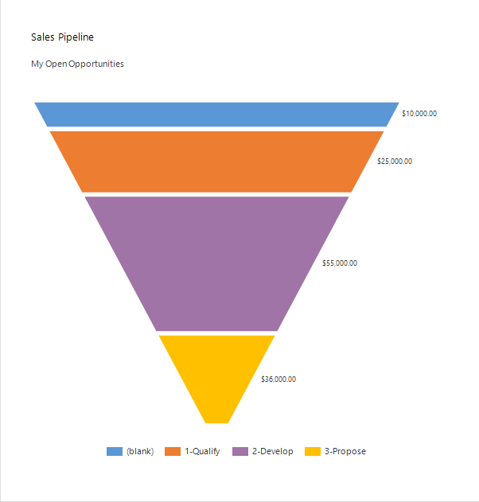
Sales Pipeline

Slide 31
Goals and Metrics

Slide 32
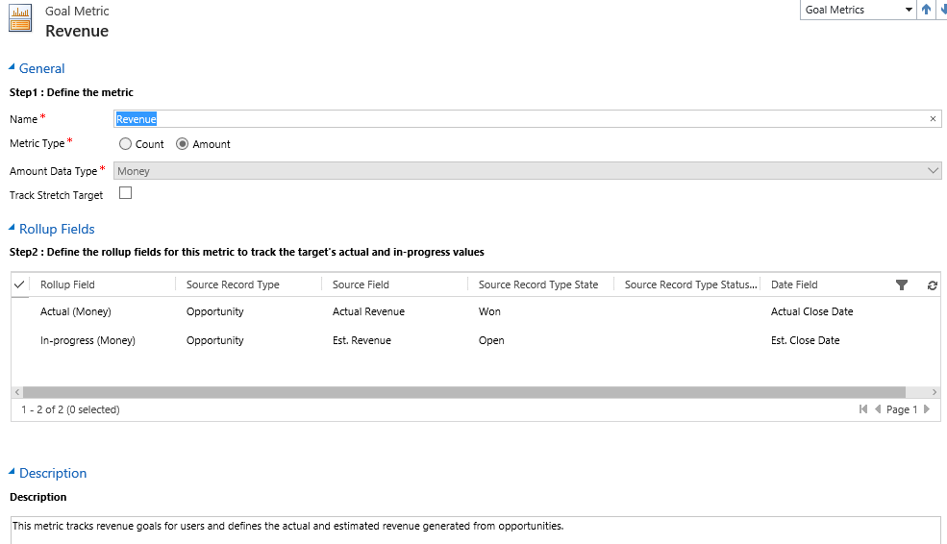
Goal Metrics

Slide 33
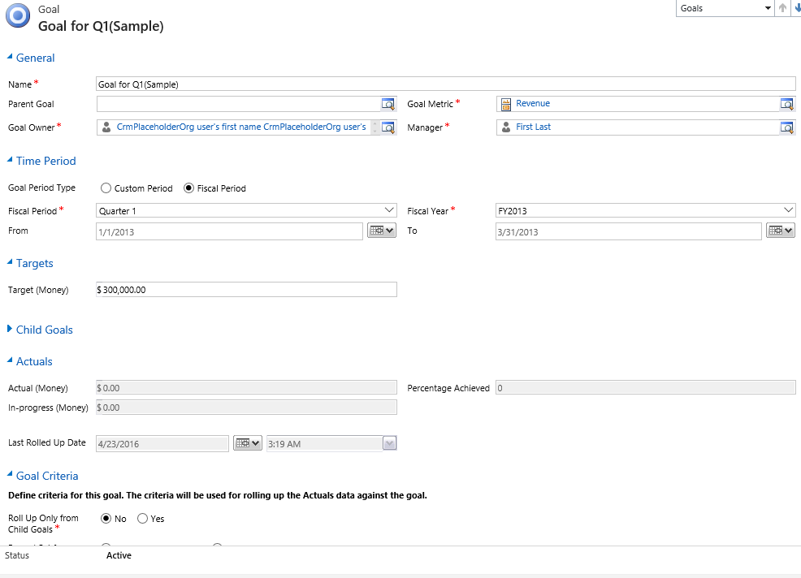
Goals

Slide 34
Tools Review
Business Process Flows
Lead
Opportunity
Metrics
Sales Pipeline
Goals

Slide 35
Tips and Tricks

Slide 36
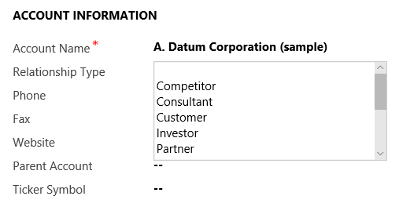
Relationship Type Field
Account
Contact

Slide 37
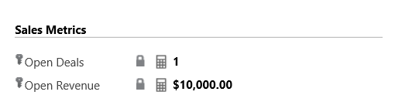
Built-in Calculated Fields

Slide 38
Custom Calculated Fields
Number of Phone calls
Number of Appointments
Etc.

Slide 39
Discussions

Slide 40
Thank You

